Slide 3
Cypher COST Action, CA22151
“Propel the collaborations between European researchers and industrial stakeholders to foster the use of cyber-physical systems and ultimately promote a safe and sustainable adoption of renewable synthetic fuels to decarbonise energy-intensive industries”
WG1: Renewable synthetic fuels (RSF) combustión
WG2: High-fidelity combustion simulations and data analytics
WG3: Hybrid physics-based data-driven models
WG4: Digital Twins and cyber-physical systems
WG5: Communication, Dissemination, Partnering with industry and policymakers

Slide 4
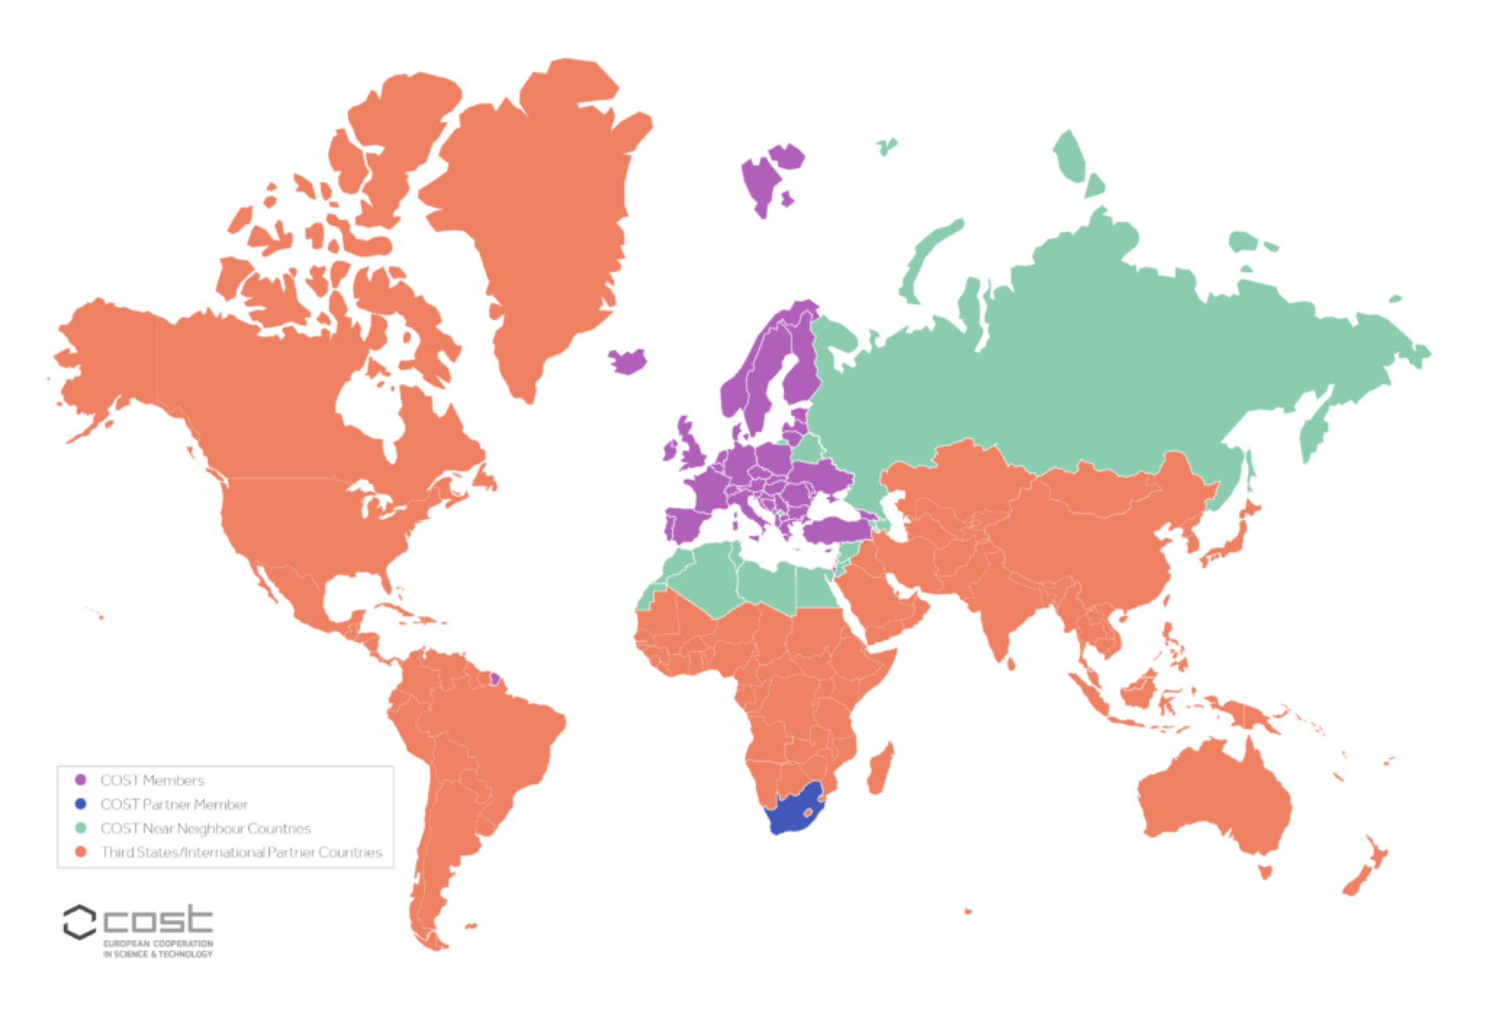
WG structure and members
32 COST Full Member countries, 1 COST Cooperating Member,1 International Partner
~300 WG members
  37% from ITC countries
  25% female members
  60% young members
  39 countries (+Algeria, Armenia, Jordan, Kosovo, Libya, Tunisia)
  20 industrial partners

Slide 5


The support of the COST Action CYPHER CA22151 and of the European Cooperation in Science and Technology (COST) association is acknowledged
COST (European Cooperation in Science and Technology) is a funding agency for research and innovation networks. Our actions help connect research initiatives across Europe and enable scientists to grow their ideas by sharing them with their peers. This boosts their research, career, and innovation.

